Slide 1

Formal Logic and Software Verification using Interactive Theorem Provers
Stephanie Weirich
University of Pennsylvania

Slide 2
Software is amazing

Slide 3

Software is amazingly buggy

Slide 4
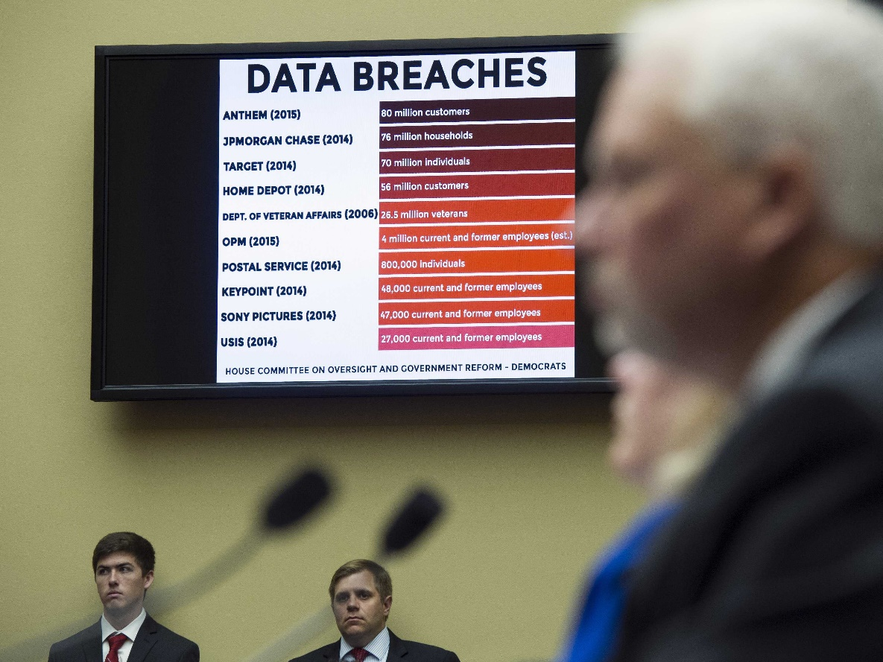
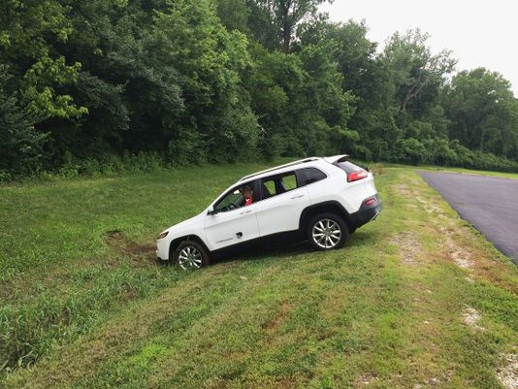
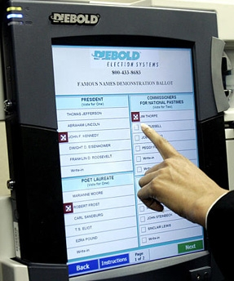
Is that bad?
Well, yes…
Car hacking
Cryptocurrency
Voting systems

Slide 5
What can we do about it?

Slide 6
Approaches to Software Reliability
Less “formal”: Techniques may
miss problems in programs
Social
Code reviews
Extreme/Pair programming
Methodological
Design patterns
Test-driven development
Version control
Bug tracking
Technological
“lint” tools, static analysis
Fuzzers, random testing
Mathematical
Sound type systems
“Formal” verification
This isn’t a tradeoff… all of these methods should be used.
Even the most “formal” can still have holes:
Did you prove the right thing?
Do your assumptions match reality?
Knuth. “Beware of bugs in the above
code; I have only proved it correct, not
tried it.”
More “formal”: eliminate with certainty as many problems as possible.
Notes:
One difference between “mathematical” and “technological” – “technological” are allowed to give false negatives

Slide 8
Formal Software Verification
Model software using mathematical logic
Specify what it means for the program to be "correct"
Prove that the program satisfies its specification
def square(x): return (x * x)
Sq(x) = x²
∀ x. 0 ≤ Sq(x)

Slide 9
Formal Software Verification
What could possibly go wrong?
Model software using mathematical logic
Specify what it means for the program to be "correct"
Prove that the program satisfies its specification
Model is not the same as the program
Program too complex to model in mathematics
def square(x): return (x * x)
Sq(x) = x²
Specification is too simple – doesn't say anything
Specification is too complex – can't understand it
∀ x. 0 ≤ Sq(x)
How do we know that the proof is correct?
It could be a lot of work to do these proofs

Slide 10
A program without a specification cannot be incorrect, it can only be surprising.”
(paraphrase of J. J. Horning, 1982)

Slide 11
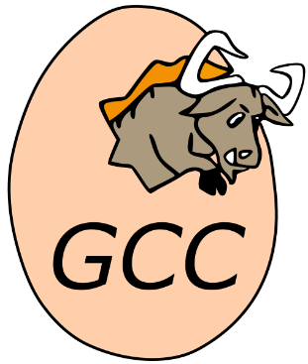
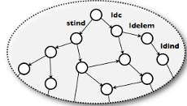
What is a specification and where does it come from?
INTERNATIONAL STANDARD ©ISO/TEC ISO/TEC 9989:2011
Programming Languages — C
This International Standard specifies the form and establishes the
interpretation of programs written in the C programming language.¹⁾
It specifies
sometimes start
from natural-language
documentation
assess versus
existing
implementations
Inductive eval_expr: expr -> val -> Prop :=
| eval_Econst_int: forall i ty,
eval_expr (Econst_int i ty) (Vint i)
. . .
| eval_Ebinop: forall op a1 a2 ty v1 v2 v,
eval_expr a1 v1 ->
eval_expr a2 v2 ->
sem_binop ge op v1 (typeof a1) v2 (typeof a2) m = Some v ->
eval_expr (Ebinop op a1 a2 ty) v
assess by
model checking
of consequences
assess by
deductive verification
of implementations
QED

Slide 12
Coq: a tool for specification and verification
Coq is:
A logic for writing programs, specifications, theorems, and proofs
A proof checker for mechanically checking proofs
A proof assistant for helping people construct proofs
A proof automation language
with libraries of “theories”
with a big user community
App spec
Application
Specification
C language
C language
Compiler
ARM instructions
Machine lang.
CPU
Transistors

Slide 13

Specifications and proofs are software artifacts
engineered,
stored,
maintained,
tested…
much like
software!
…. … ……. . .. …. ….. …. .. …
.. .. …… …. ……. … ……
….. … … ……. .. . .. …………….. …………
.. …………… …. . . …. ….
. ….. ………….
…. … ……. . .. …. ….. …. .. …
.. .. …… …. ……. … ……
….. … … …….
Inductive eval_expr: expr -> val -> Prop :=
| eval_Econst_int: forall i ty,
eval_expr (Econst_int i ty) (Vint i)
. . .
| eval_Ebinop: forall op a1 a2 ty v1 v2 v,
eval_expr a1 v1 ->
eval_expr a2 v2 ->
sem_binop ge op v1 (typeof a1) v2 (typeof a2) m = Some v ->
eval_expr (Ebinop op a1 a2 ty) v
… ……. . .. …. ….. …. .. …
…... .. …… …. ……. … ……
….. … … ……. .. . .. …………….. …………
.. …………… …. . . …. ….
….. … … …….

Slide 14
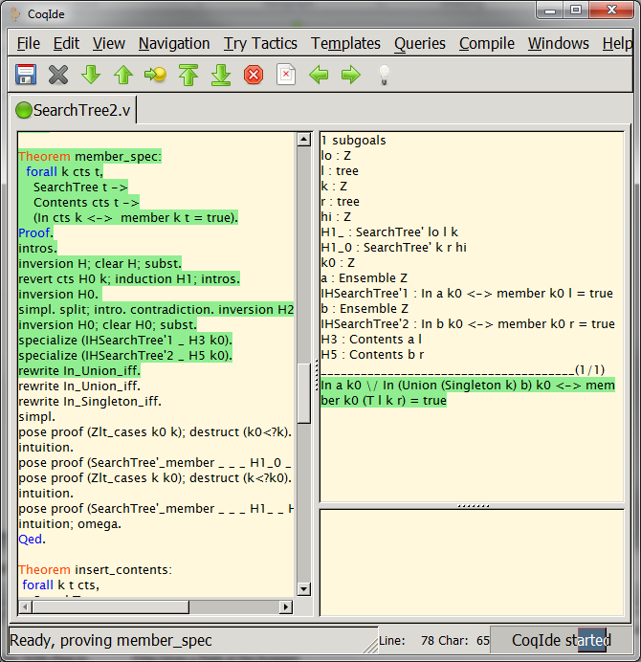
Statement
of a theorem
Proof script
accepted
so far
Current
proof
goal
Proof script
yet to be
checked

Slide 15
Does it work for real software?

Slide 16
COMPCERT
Verified C compiler [Xavier Leroy 2006]
Accepts most of ISO C 99, produces machine code for most processors (x86, PowerPC, ARM, RISC-V)
Competitive performance with gcc

Slide 17



Does it work?
Finding and Understanding Bugs in C Compilers [Yang et al. PLDI 2011]
Random test-case generation
79 bugs:
25 critical
Source Programs
202 bugs
325 bugs in total
LLVM
{8 other C compilers}
Verified Compiler: CompCert [Leroy et al.] <10 bugs found in unverified front-end component

Slide 18
Regehr’s Group Concludes
The striking thing about our CompCert results is that the middle-end bugs we found in all other compilers are absent. As of early 2011, the under-development version of CompCert is the only compiler we have tested for which Csmith cannot find wrong-code errors. This is not for lack of trying: we have devoted about six CPU-years to the task. The apparent unbreakability of CompCert supports a strong argument that developing compiler optimizations within a proof framework, where safety checks are explicit and machine-checked, has tangible benefits for compiler users.
(emphasis mine)

Slide 19
Many other success stories
and many, many more!

Slide 20
How do we make software verification common practice?

Slide 21

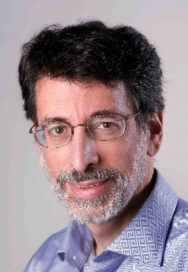

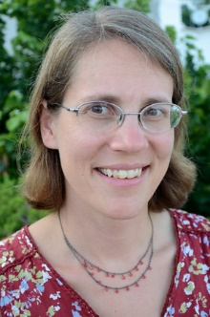


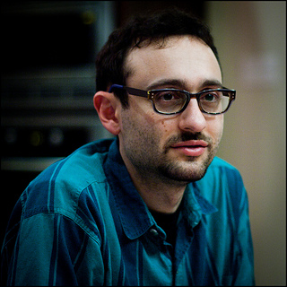
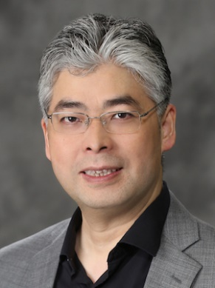




National Science Foundation Expedition in Computing
Andrew
Appel
Lennart
Beringer
Stephanie
Weirich
Benjamin
Pierce
Steve
Zdancewic
Adam
Chlipala
Zhong
Shao
Princeton
Penn
MIT
Yale
www.deepspec.org

Slide 22
Deep Specifications are RICH, FORMAL, 2-SIDED, and LIVE
RICH | describe complex behaviors in detail
FORMAL | in notation with a clear semantics
2-SIDED | connected to both implementations & clients
LIVE | machine-checked connection to implementations

Slide 23
The whole is more than the sum of its parts
HTTP
Specifications can be LARGE
and COMPLEX
Bugs occur not only in modules,
but in specifications
Proving a program correct,
but to the wrong spec., can
be a problem!
Web
Server
Specification
C language
C language
Compiler
ARM instructions
Machine lang.
CPU
Transistors

Slide 24
The whole is more than the sum of its parts
HTTP
When we connect components
and proofs at specification
interfaces,
internal specs “drop out” of
the end-to-end correctness
theorem!
Web
Server
End-to-End
Specification
C language
C language
Compiler
ARM instructions
Machine lang.
CPU
Transistors

Slide 25

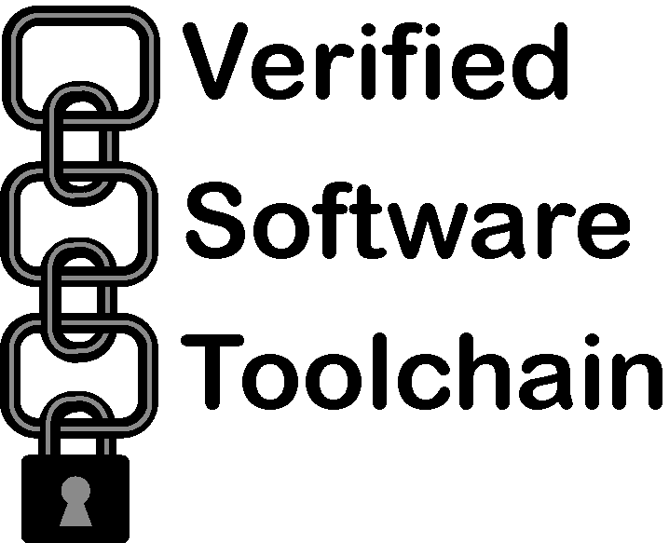



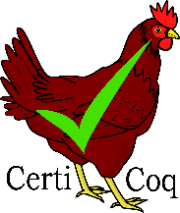
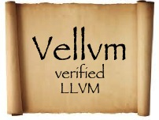
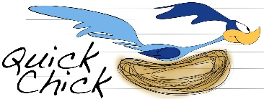
The parts
A whole

Slide 26
Want to try it out?

Slide 27
Try it yourself
https://x80.org/rhino-coq/v8.6/examples/sf/Basics.html

Slide 28
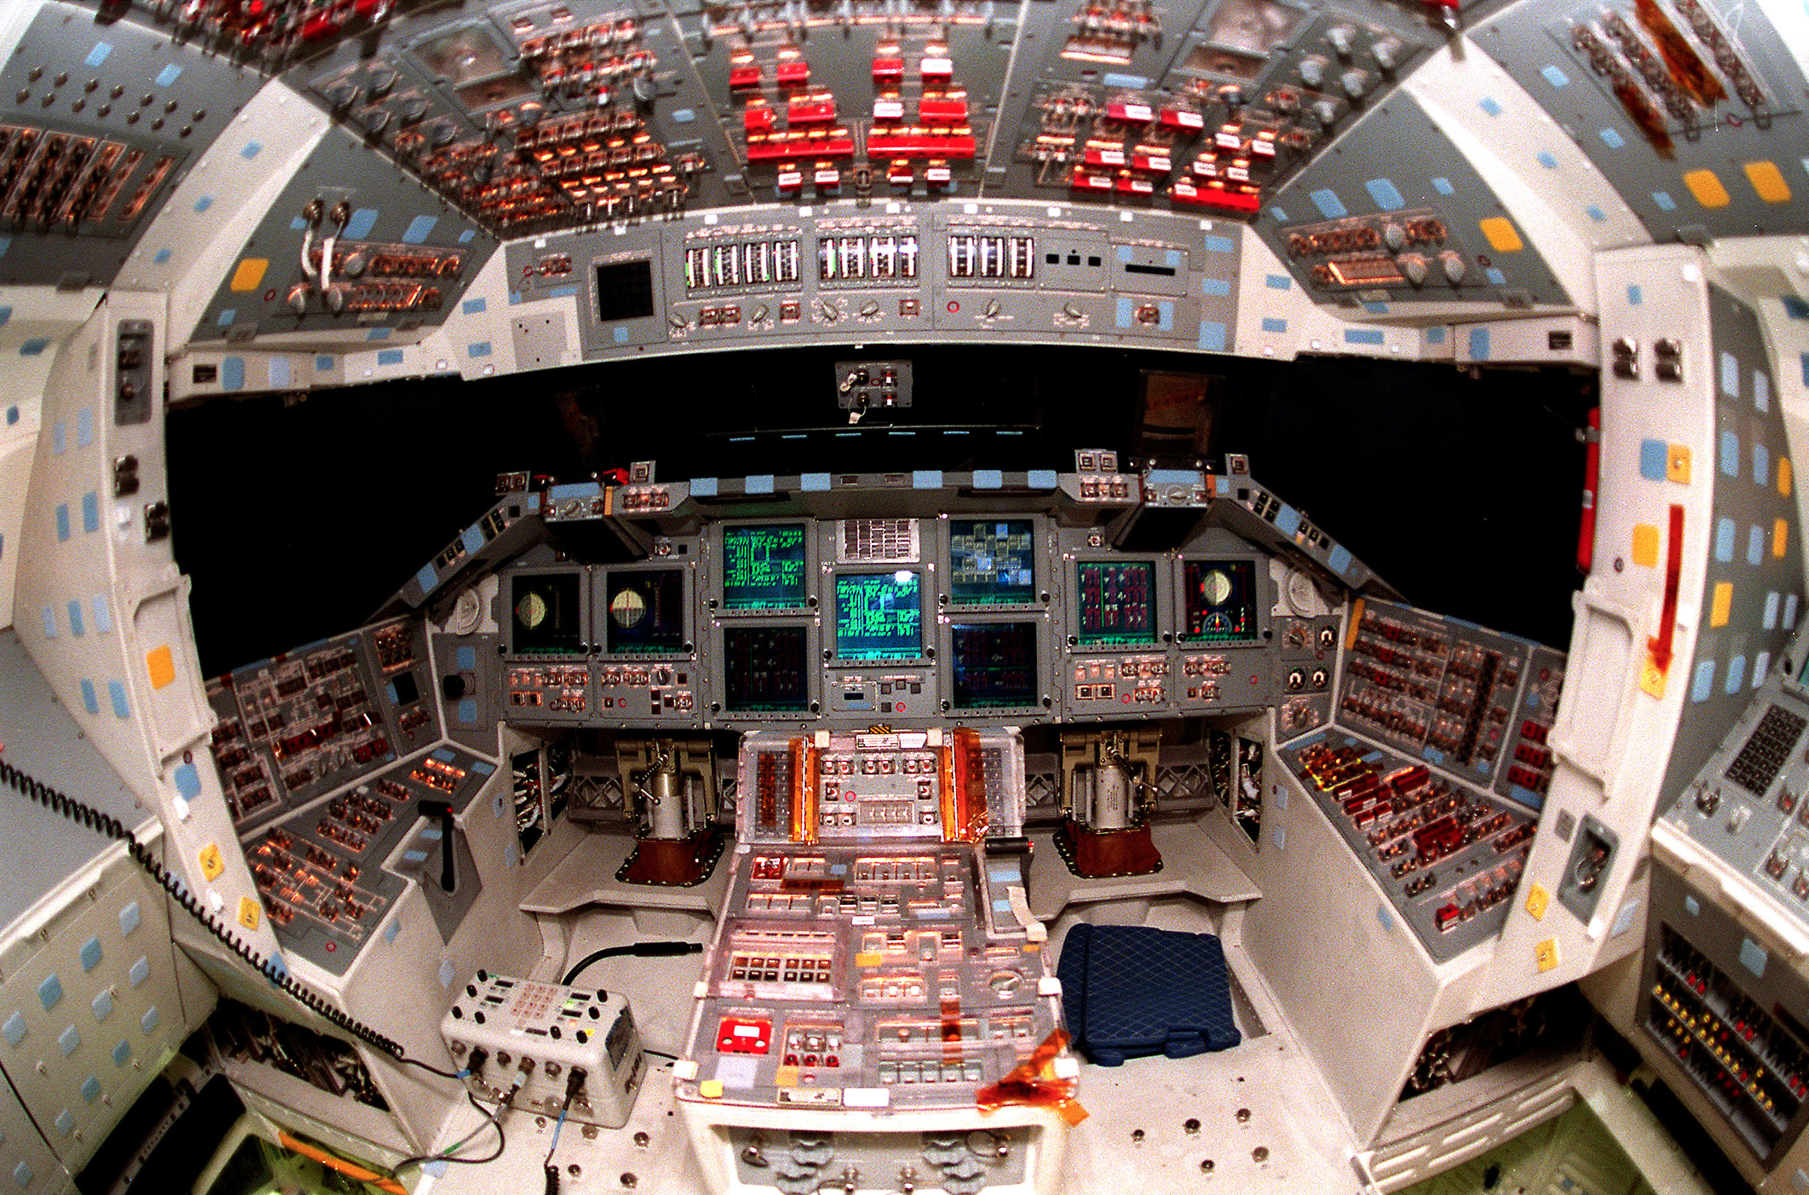
Coq’s Full System

Slide 29
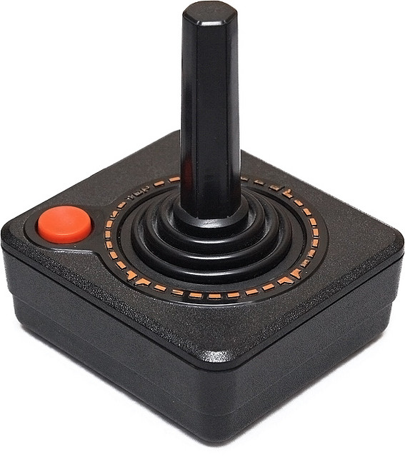
Subset Used today

Slide 30
Software Foundations
https://softwarefoundations.cis.upenn.edu/
Available online

Slide 31
Join us!
PhD and postdoc positions
Summer schools https://deepspec.org/event/dsss18/
Visit deepspec.org to see what’s happening and join our mailing list
@deep_spec

